Slide 1
Arizona Independent Redistricting Commission Round II Hearings

Slide 2
Overview
Arizona’s redistricting process is governed by the state Constitution, as amended by voters in 2000 with the passage of Proposition 106. It stipulates that the Arizona Independent Redistricting Commission redraw Arizona’s congressional and legislative districts to reflect the results of the most recent census.
Due to the 2010 Census, Arizona gained a congressional seat.

Slide 3
What are the requirements of the State Constitution via Prop 106?
New district boundaries must:
A: Comply with the U.S Constitution and the Voting Rights Act
B: Equal Population
Criteria A and B are federally mandated.
To the extent practicable the districts must be:
C: Compact and Contiguous
D: Respect communities of interest
E: Use visible geographic features, city, town and county boundaries, and undivided Census Tracts
F: Favor competitive districts where no significant detriment to other goals

Slide 4
A: Voting Rights Act
Arizona’s congressional and legislative districts must receive preclearance or approval from the Department of Justice or a federal court under Section 5 of the Voting Rights Act before they can take effect. To get preclearance, Arizona must demonstrate that the new districts do not discriminate against minority voters in purpose or effect, which means there can be no intentional or accidental discrimination.
Under Section 5, Arizona's redistricting plans cannot be retrogressive. The plans cannot weaken or reduce minority voters' rights.
The presence of discrimination can be determined by analyzing population data and election results.

Slide 5
Bruce L. Adelson, Esq. Federal Compliance Consulting LLC
5

Slide 6
Timeline
Step 1: Setting up the Commission – Commissioners are appointed following a thorough screening process.
Step 2: First-Round Hearings
Before drawing a single line, the Commission held 23 public hearings around the state in July and August to get input from members of the public about issues relevant to redistricting such as geography, communities of interest, minority voting rights, and competitiveness.
Scott Freeman, Vice Chair | Jose Herrera, Vice Chair | Colleen Mathis, Chair | Linda McNulty | Richard Stertz
Republican | Democrat | Independent | Democrat | Republican
Maricopa County | Maricopa County | Pima County | Pima County | Pima County

Slide 7
Timeline
Step 3: Mapping –
Start with a clean slate
Then divide the state into equal population and compact grid like districts -- Grid Map Approved August 18
Since adopting the grid maps, the Commission has met more than 25 times to consider adjustments to the grid to accommodate all of the state constitutional criteria. During this time they received additional public comment and draft maps.
Approval of Draft Maps – On October 3, the Commission approved draft congressional map that incorporated changes based on all of the constitutional criteria. It approved draft legislative map on October 10.

Slide 8
Timeline
Step 4: Second Round Hearings –
Currently visiting 30 towns and cities to share the draft maps and receive additional public input during the month of October and November
Step 5: Final Maps
Upon completion of a public comment period, the AIRC will adopt final maps
Step 6: Preclearance
Because Arizona is subject to Section 5 of the Voting Rights Act, the district maps must be approved by the federal Department of Justice or the federal court in Washington, D.C. before they can be used for Arizona elections

Slide 9
Congressional Map used in 2010

Slide 10
Starting Point -- Congressional Map

Slide 11
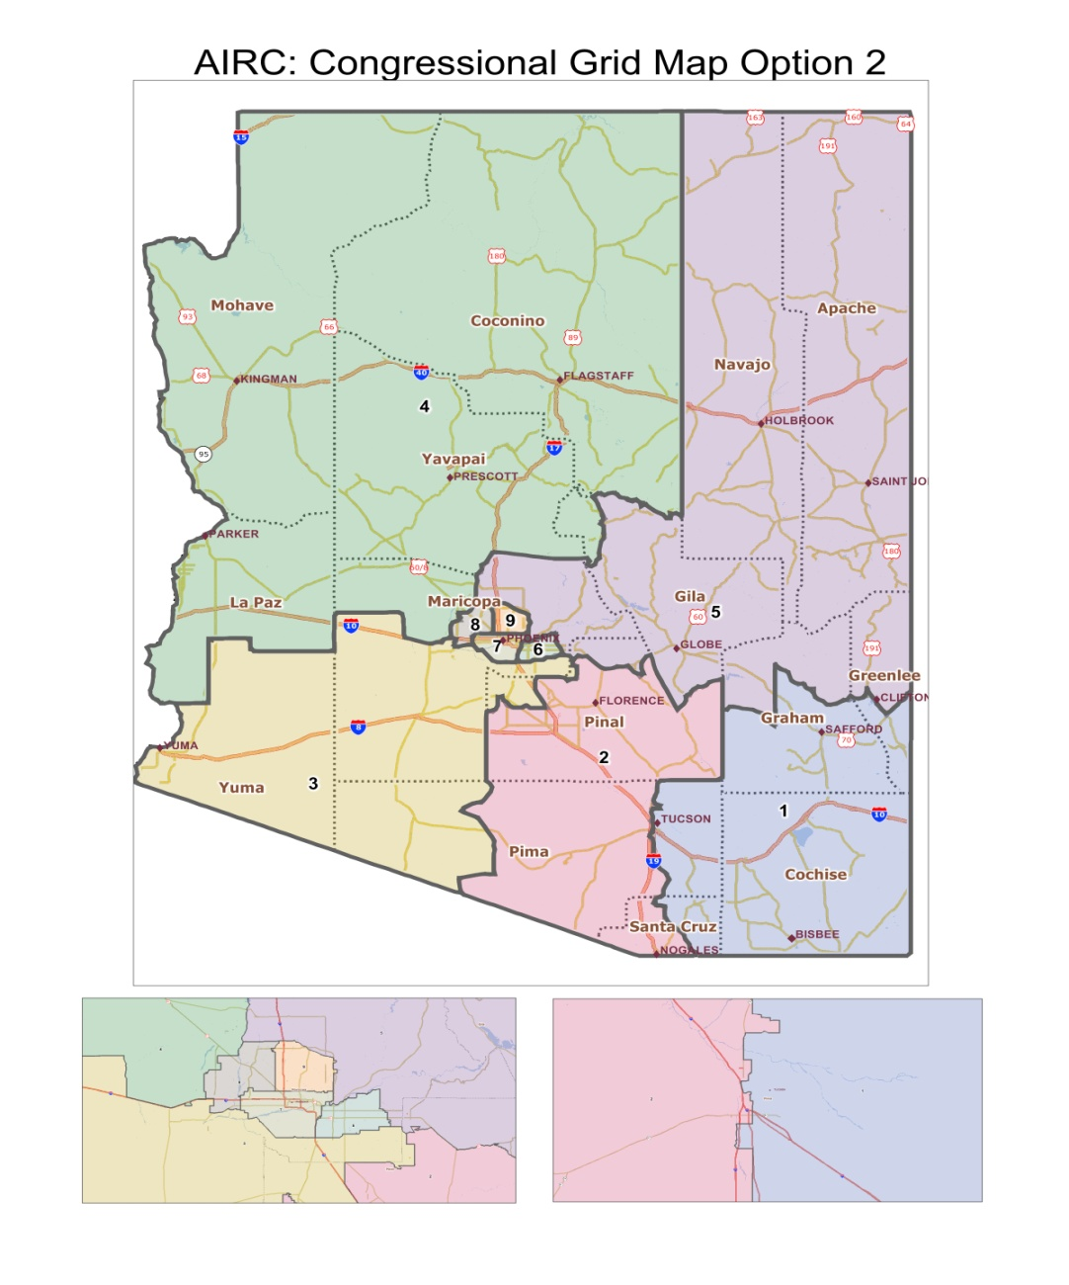
Congressional Grid Map

Slide 12
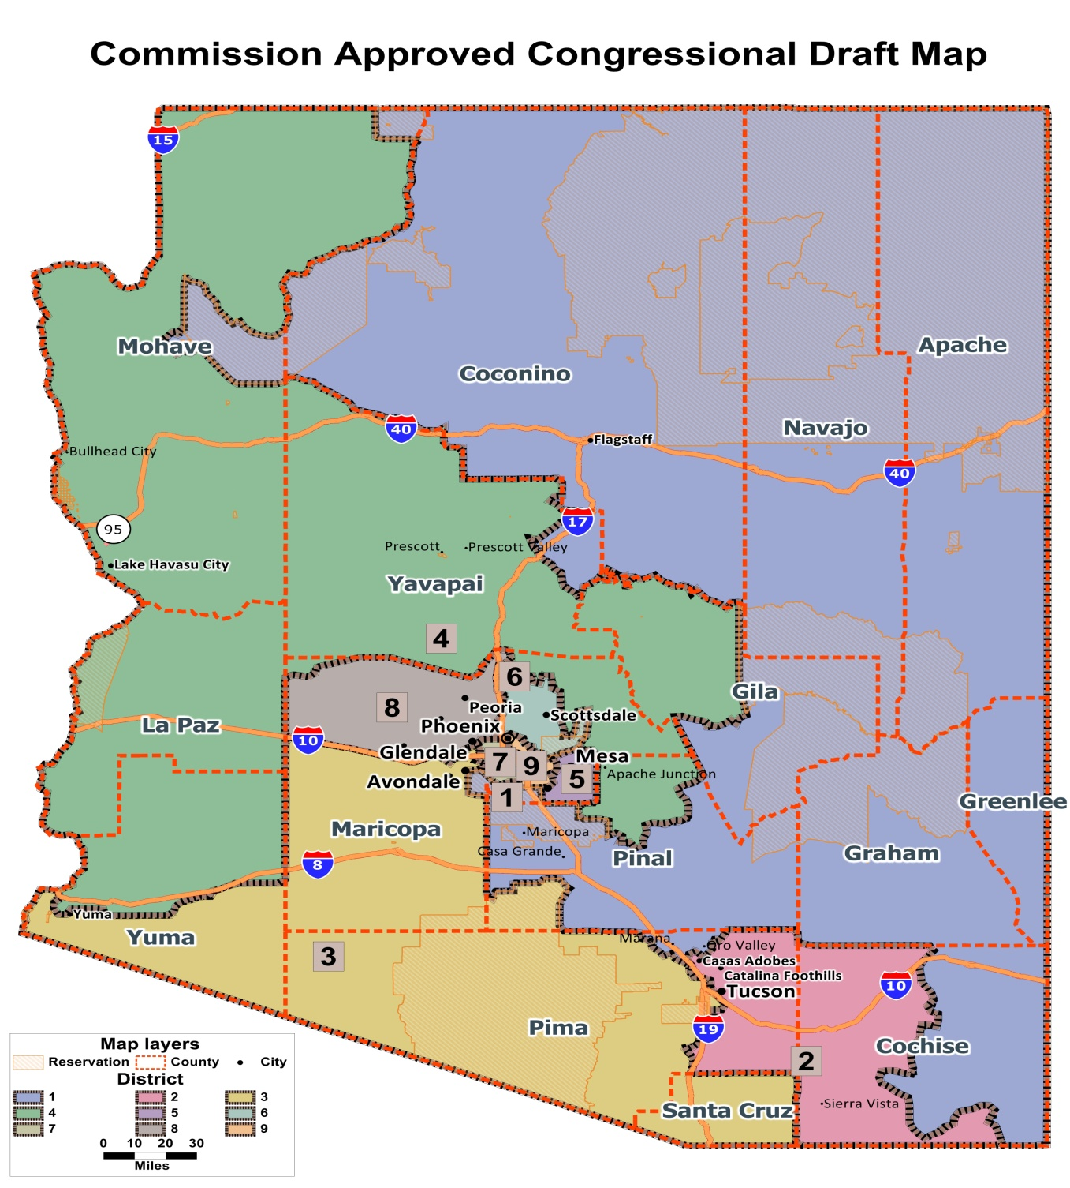
Congressional Draft Map
The draft congressional districts include:
Two predominantly rural districts
Three border districts
Three districts in the greater Tucson region
Five districts that are entirely in Maricopa County
It avoids splitting Arizona's Indian Reservations
Two districts where minority voters have the opportunity to elect their candidate of choice

Slide 13
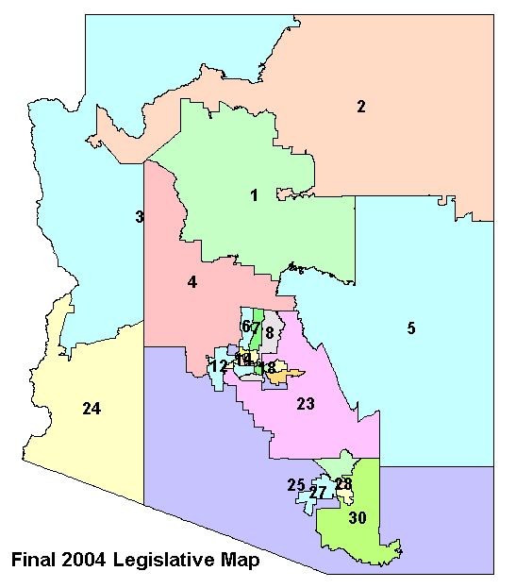
Legislative Map used in 2010

Slide 14
Starting Point -- Legislative Map

Slide 15
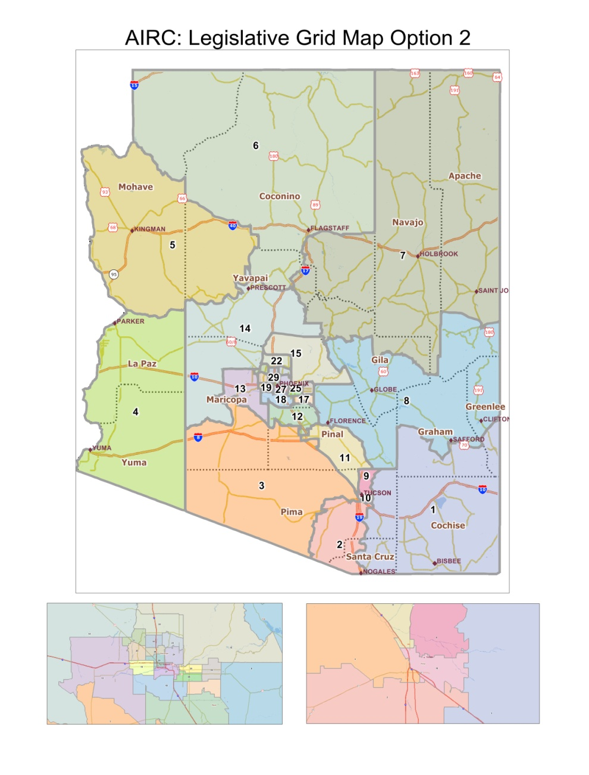
Legislative Grid Map

Slide 16
Legislative Draft Map
The draft legislative districts include:
Population growth and reduction:
Old districts -- about 155,000 to 378,000
Current draft -- about 207,000 to 215,000
To comply with the Voting Rights Act, the draft plan includes ten districts in which minority voters should have the opportunity to elect their candidate of choice.
The draft includes
Three districts wholly within Pima County (districts 3, 9 and 10) and three additional southern Arizona districts (1, 2 and 4)
17 districts primarily within Maricopa County (12, 15-30)
9 districts primarily rural (1, 4, 5, 6, 7, 8, 11, 13, 14)

Slide 17
The AIRC Wants Your Input
Fill out a request to speak form at a public hearing and provide the commission you input. Example of input includes thoughts on:
All Constitutional Criteria
Draft Congressional Map
Draft legislative Map
You can submit your input by:
Speaking at a hearing
Filling out a public input forms at the hearing or on the AIRC website
Visit us at www.azredistricting.org or call 602-542-5221 or toll free at 855 – 733-7478
17

Slide 18
The AIRC Wants You to Stay Connected
Meetings
Maps
Public Input
18
Maps

Slide 19
Finding Draft Maps
19

Slide 20
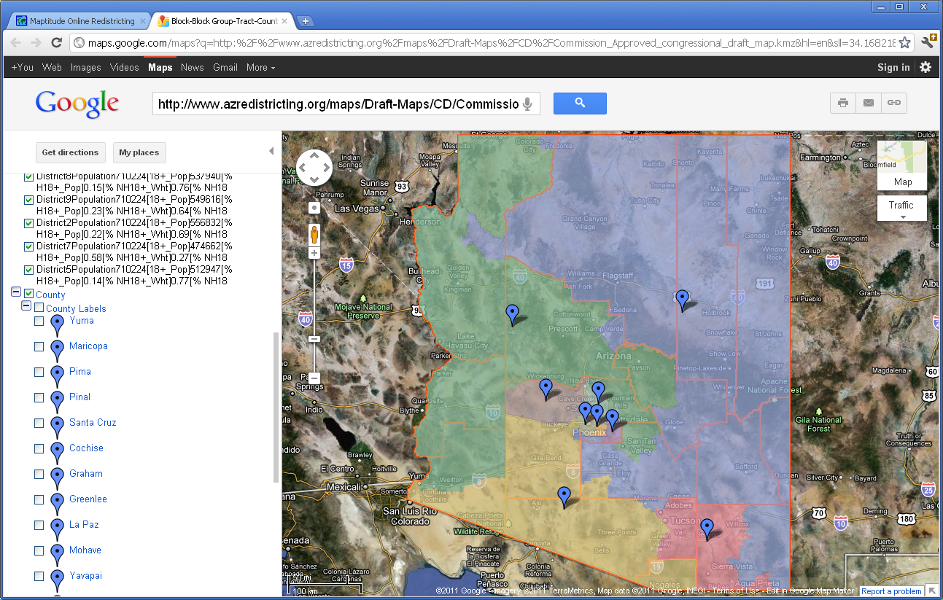
Viewing the KMZ (Google) Map
20

Slide 21
Zoom in on your district
21

Slide 22
The AIRC Wants You to Stay Connected
Visit our website at: www.azredistricting.org to
Draw your own maps
Watch current meetings or past meetings
Get updates on future meetings
Follow us on Twitter #AIRC
Friend us on Facebook http://www.facebook.com/#!/azredistricting
22

